Slide 1
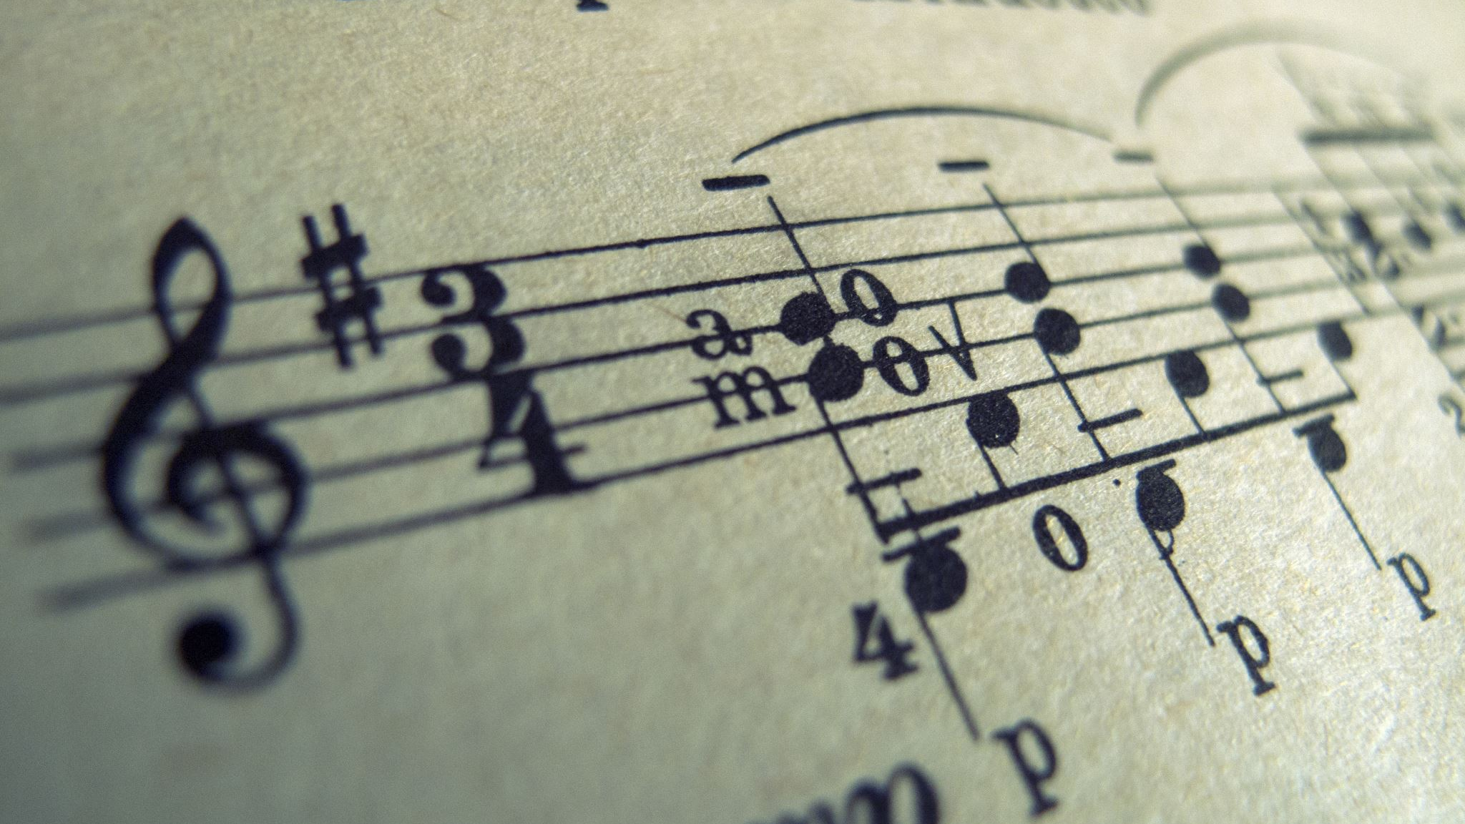
Sentiment Analysis of Musical Tracks

Slide 2
Introduction
Problem Statement
Project Goal
To classify songs based on different moods: Happy, Sad, and Neutral
Building features from lyrics using NLP and applying classification algorithms like Naive Bayes, Random Forest, KMeans, and Support Vector Machines (SVM) to identify the moods of songs.

Slide 3

Execution Flow
Creating Labels using Sentiment Intensity Analyzer
Threshold for labelling.
Neutral - 6.62%
Sad - 30.07%
Happy - 63.31%
Data Cleaning
Data Analysis
Evaluated the best model through F1 weighted & Accuracy
Supervised and Unsupervised models to classify moods
Feature Building through
Count Vectorizer
80/20 split with Stratified Sampling

Slide 4
Dataset
01
02
03
6067 songs
Dataset was in multiple csv files that had song lyrics and artists along with the years and concatenated them to simplify our initial analysis
The lyrics column in the data needs to be cleaned by removing any punctuation marks, stop words, and non-English words. Also, the null entries were removed.
Year was used to create buckets of ‘decades’ such as the nineties, twenty tens etc. to analyze and look out for the most common words and helped us understand the sentiment
21 Artists
5 Decades

Slide 5
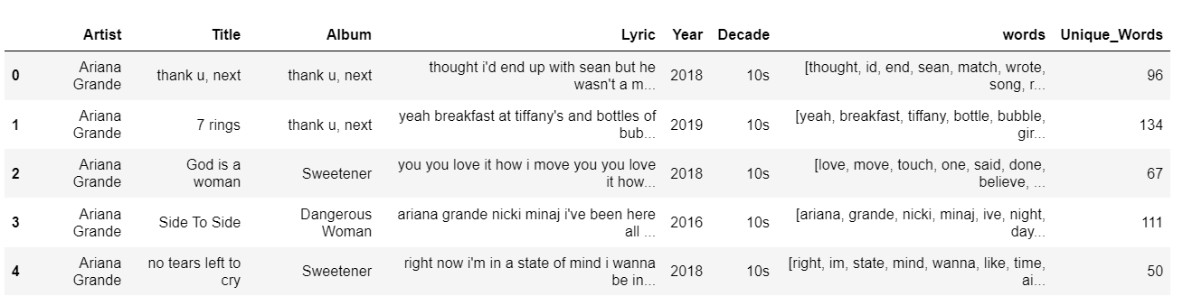
Data Analysis
Records present in each decade.
Creating word columns from lyrics.
Decade | Records
90s | 75
00s | 900
10s | 2817
20s | 448

Slide 6
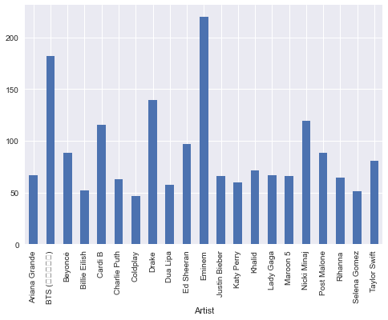
Songs before 2000 had more words than those after 2000s
Rappers bombarded the songs with words (E.g. Eminem and Drake have lot meaningful words)
Decade | Unique Words
80s | 188
90s | 189
00s | 111
10s | 104
20s | 93

Slide 7
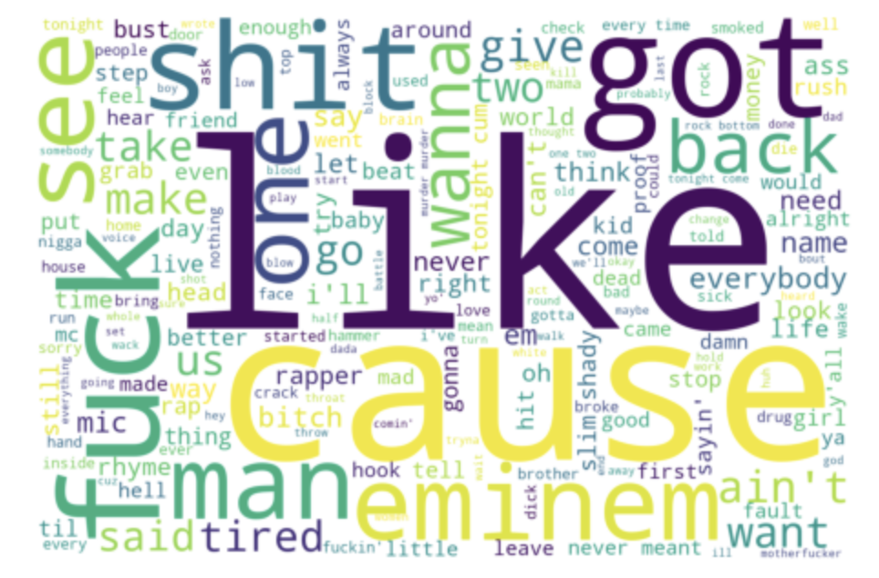
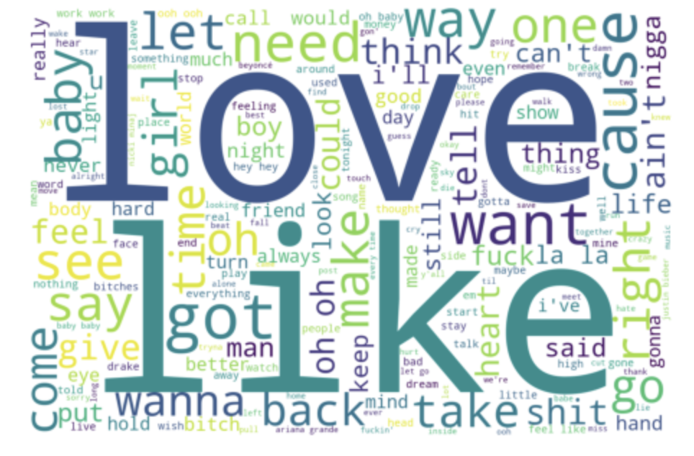
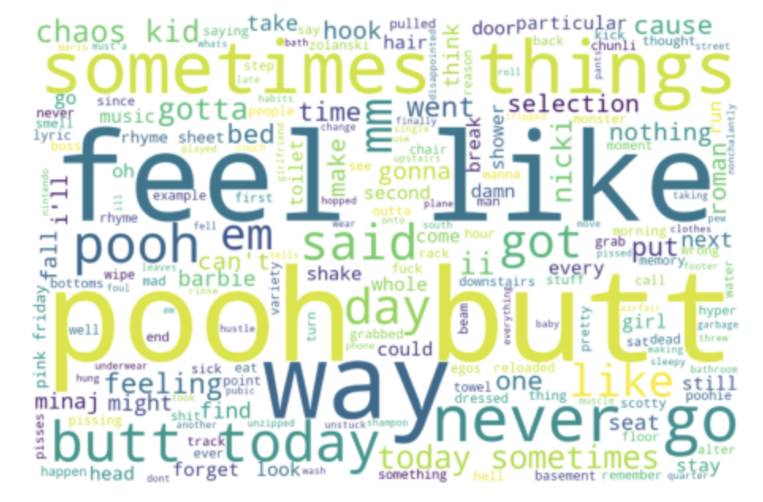
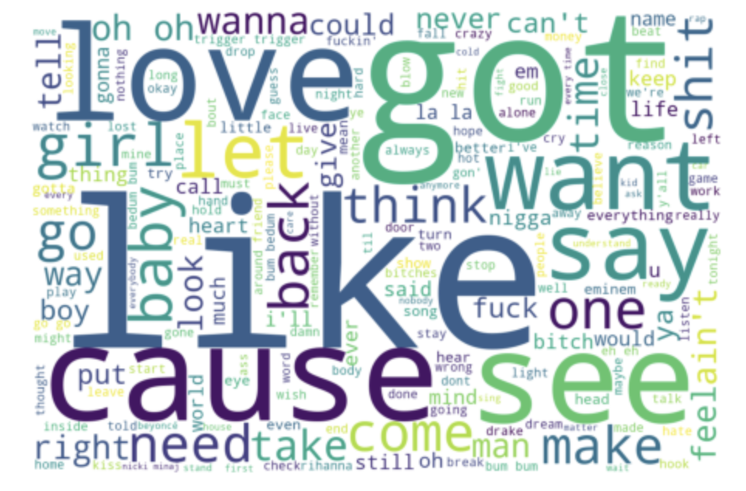
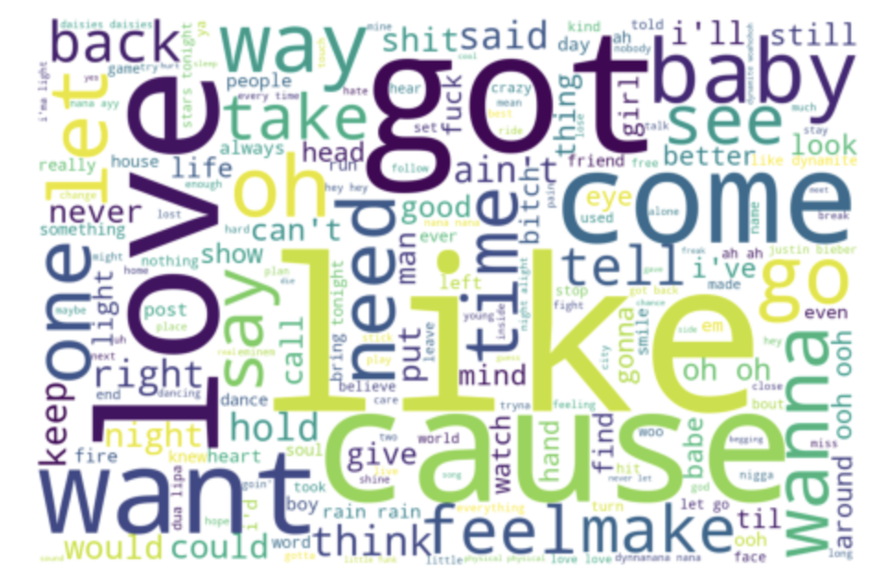
Word-Cloud
80s
90s
00s
10s
20s

Slide 8
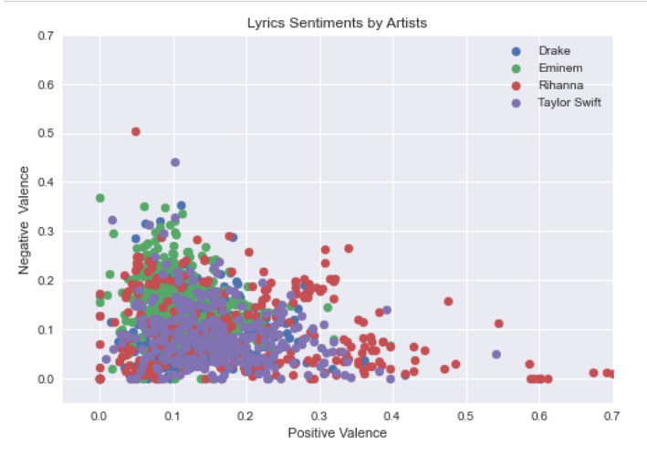
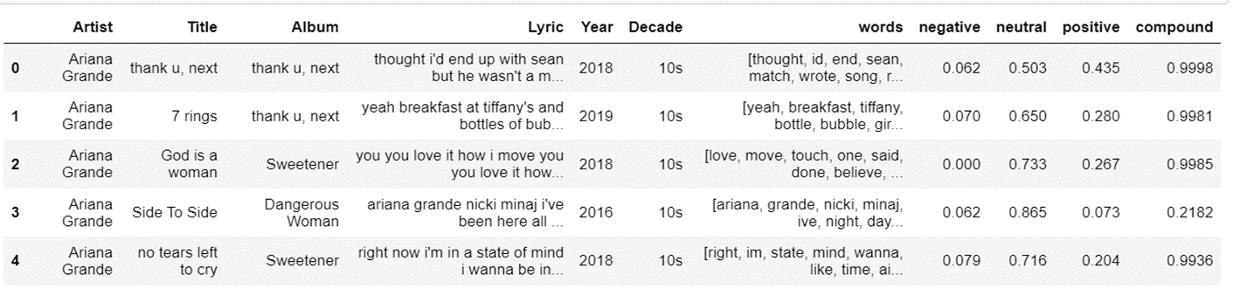
Sentiment Intensity Analyzer
No labels i.e mood of songs present in dataset to build classification models
Assigned Mood of songs using Sentiment Intensity Analyzer from NLTK by finding the aggregate polarity(positive, negative, neutral) of each word in Lyric.
Got “Compound score” that signifies overall sentiment of the text: 1 being maximum positive to -1 being maximum negative.
Plotted the Negative and Positive Score for selected artists. (Rihanna had more positive tone to her songs)

Slide 9
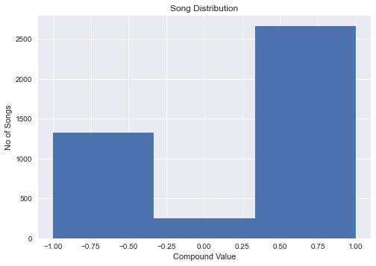
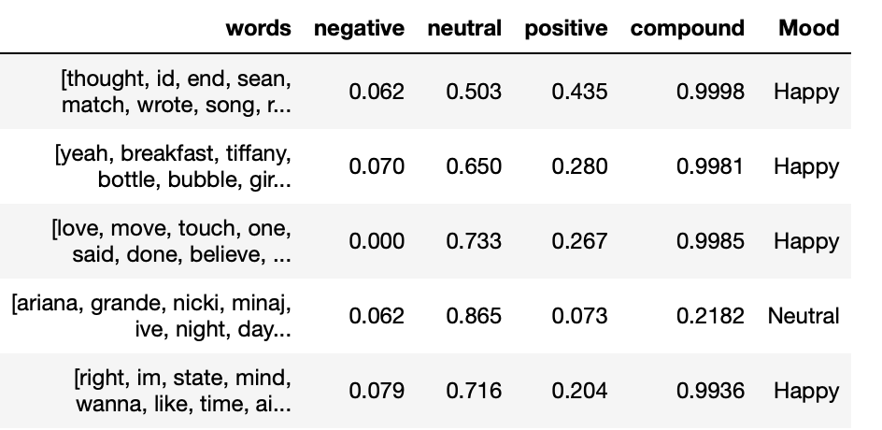
Labelling the Mood of Songs
Based on the Distribution of songs, came up with cutoff values to assign the mood of the song. As seen from the histogram below, we decided to assign these ranges
 | Compound Score | No of Songs
Happy | (0.3,1] | 3,786
Neutral | [-0.3,0.3] | 1,799
Sad | [-1,-0.3) | 396

Slide 10
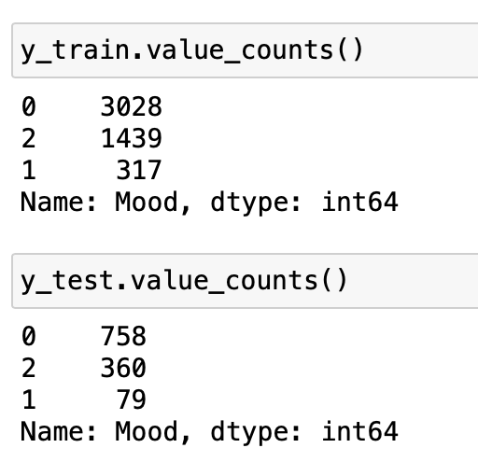
Model Building
Since the Classes are imbalanced, used stratified sampling to create balanced spit of each class in training and testing sets
No of records in train and test splits.

Slide 11
Model Pre-processing
Stemming - Porter
Stemming - Snowball
Count Vectorizer Transform text into vector based on frequency of words
Data
Raw Words Vocab Size 35,759
01
Remove the suffixes from an English word and obtain its stem
Vocab Size: 27,926
02
Uses a more general framework that allows for easier customization.
Vocab Size: 27,871
03

Slide 12
Model Performance Evaluation: Accuracy
 | CountVec | CountVec Porter | CountVec Snowball
Random Forest | 77.45% | 77.69% | 77.52%
Naïve Bayes | 74.54% | 73.66% | 73.79%
SVM(Linear) SVM(Radial) | 74.52% 73.82% | 74.94% 74.47% | 74.94% 74.24%
KMeans | 37.85% | 15.32% | 54.22%
Accuracy based on 3 fold Cross Validation on Training data

Slide 13
Model Performance Evaluation: F1-weighted Score
 | CountVec | CountVec Porter | CountVec Snowball
Random Forest | 75.75% | 76.01% | 75.79%
Naïve Bayes | 72.54% | 71.69% | 71.82%
SVM(Linear) SVM(Radial) | 74.52% 68.99% | 74.94% 69.87% | 74.94% 69.62%
KMeans
Not a suitable parameter for Unsupervised models
F1-weighted score based on 3 fold Cross Validation on Training data

Slide 14
Test Results
Based on our analysis of accuracy and f1-weighted score based on 3 fold Cross Validation, Random forest gives the most accurate results.
Test Accuracy : 79.2%
Test F1 Weighted : 77.7%

Slide 15

Application
When applied to song lyrics, sentiment analysis can create playlists or curated music experiences that cater to specific emotional states or activities
By analyzing the sentiment of lyrics (mood), we can better understand the impact of music on listeners and the cultural significance of different genres and artists.
Lastly, classifying the moods of songs can also be useful for music producers, marketers, and advertisers who are trying to understand the emotional impact of music on their audience.

